Slide 1
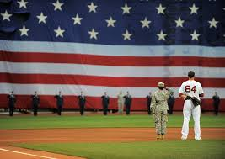
Baseball During Wartime

Slide 2
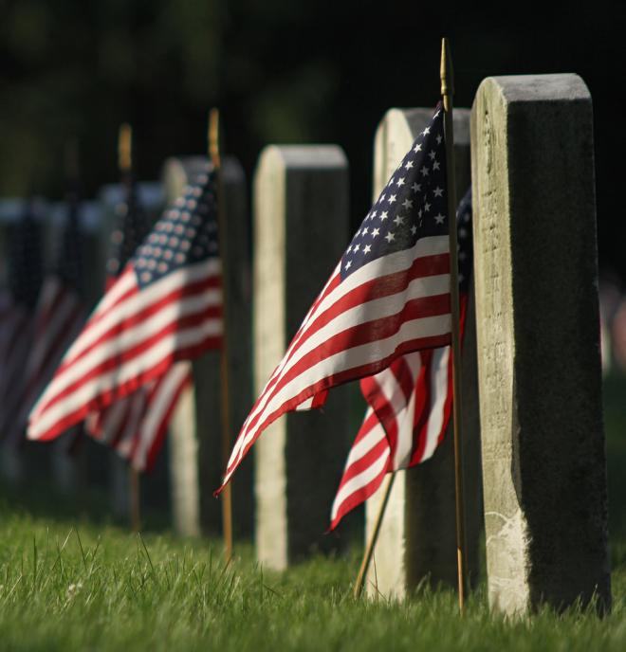
“Ballplayers, like every other American citizen, understand the importance of giving one's self for their country.” –
Baseball Hall of Fame
Professional Ballplayers killed in a combat zone:
WW I – Majors -8/ Minors-25/Negro Lg-2
World War II – Majors - 2/Minors - 151
WW II – 70 Japanese pro ballplayers
Korean War - Majors- 1/ Minors - 19
Vietnam – 9 minor league players
Post Vietnam – 1 minor leaguer
Notes:
Hundreds of men who served in the military during wartime played major league baseball; and thousands more spent time playing for minor league teams. Most of these men survived the war, and continued their careers on the field, but a small number paid the ultimate sacrifice, and never returned to the field. A total of 11 major league ballplayers were killed in a combat zone during World War I, World War II and the Korean War; and 205 minor league players lost their lives.
We thank each of them for their service.
We thank all service men and women for allowing us to live free in the greatest country in the history of the world. Your sacrifices will never be forgotten.
We regret that we cannot recognize each person individually.

Slide 3
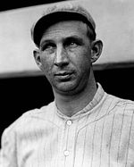
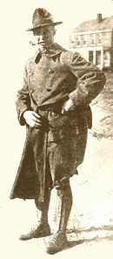
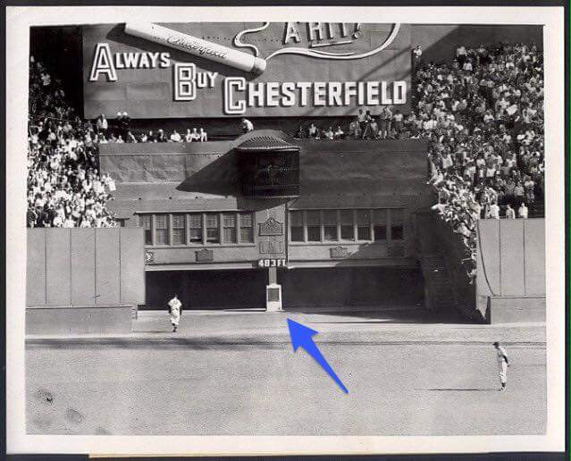
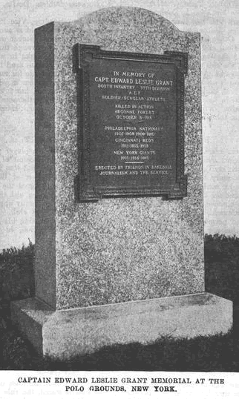
Captain Eddie Grant
First Major League Player Killed in World War I
Notes:
Eddie Grant had a 10 year career as a 3B from 1905-1915, with Phillies, Reds and Giants. He had a lifetime batting average of .249 in 990 games, and played in the 1913 World Series. Grant was a Harvard educated lawyer, and retired from baseball in 1916 – but, that didn’t last long. When US declared war on Germany in 1917. Grant was the first major leaguer to enlist .
He was a captain in the 77th Infantry Division. During the battle of the Argonne Forest, all of Grant's superior officers were killed or wounded, and he took command of his troops on a four-day search for the "Lost Battalion." During the search, an exploding shell killed Grant on October 5, 1918.
In 1921, the Giants installed a monument to Grant at the Polo Grounds ballpark. It was in dead centerfield, and the ball was in play even if it hit the monument. A replica of that plaque can now be seen at AT&T Park in SF.

Slide 4
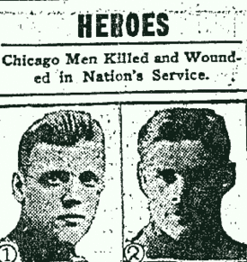
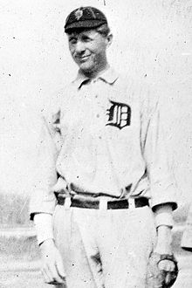
Sgt. Robert “Bun” Troy Alex “Tom” Burr, Army Pilot
Major League Players Killed in World War I
Notes:
“Bun” Troy was born in Germany in 1888, and grew up in Pennsylvania. He pitched in one major league game for Detroit in 1912. However, as a minor league player from 1912-14, he won 65 games while pitching more than 900 innings during those three seasons.
Troy was a sergeant with the "Blue Ridge" Division of the United States Army; he was shot in the chest during Meuse-Argonne Offensive in October 1918.
Tom Burr appeared in one game with the Yankees in 1914. He enlisted in Army in 1917, and died in a plane crash in France on October 12, 1918.

Slide 5
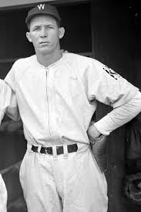
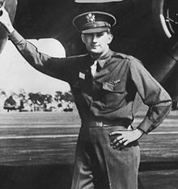
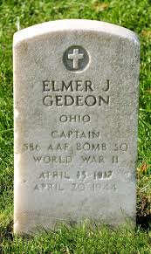
Captain Elmer Gedeon, U.S. Army Air Force
Washington Senators OF
Captain Gedeon died on April 20, 1944 when his B-26 bomber was shot down during a bombing raid over Calais, France
Notes:
Gedeon was an outstanding athlete at Univ. of Michigan – an All American in track and field, as well as a member of baseball and football teams. Signed with Senators, and played 5 games as outfielder before he was drafted in 1941.
Captain Gedeon Lost his life in April, 1944 when his B-26 was short down over France.

Slide 6
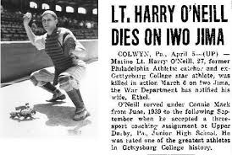
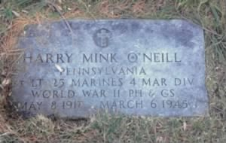
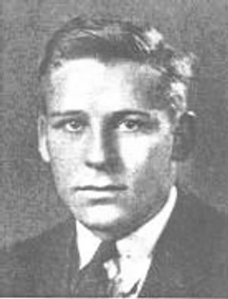
1st Lt. Harry O’Neill, United States Marines
Philadelphia Athletics C
Lieutenant O’Neill was killed by a sniper on Iwo Jima on March 6, 1945.
Notes:
O’Neill was a catcher in the Philadephia A’s organization, appeared in one ball game in 1939. He also played semi-pro basketball and football. He enlisted in the Marines in 1942. He died in March 1945, the result of a sniper’s bullet on Iwo Jima. He was one of 92 officers from the 4th Marine Div. who diied on Iwo Jima.

Slide 7
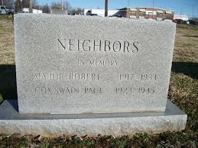
Major Robert “Bob” Neighbors, U.S. Air Force
St. Louis Browns SS
Major Neighbors is the last major league player to die in action during war time.
Notes:
Bob Neighbors played shortstop for the St. Louis Browns in 1939, and played 6 seasons in the minor leagues. He joined the Army Air Force in 1942, and served stateside throughout WW-2. After the war, he remained in the Air Force and gained the rank of major. He saw his first combat action in the Korean War. In Korea, Major Neighbprs and his B-26 crew were shot down on August 8, 1952. The bodies of all crew members have never been recovered. Neighbors is the last major league player to die in action during wartime.

Slide 8
HALL OF FAME PLAYERS
WHO SERVED IN
WORLD WAR I AND WORLD WAR II
Notes:
Several notable players served during wartime, including an impressive list of Hall of Famers: 27 members of the HOF served during WW I – 36 HOF members served in WW II – and in the Korean War, another six HOFers served.

Slide 9
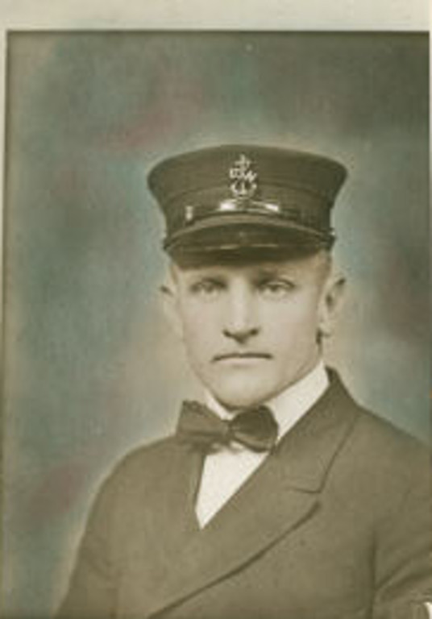
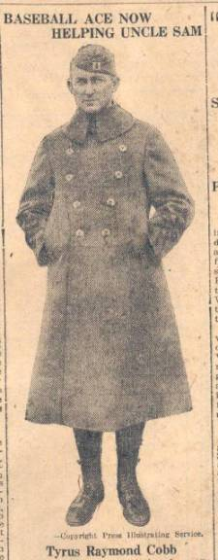
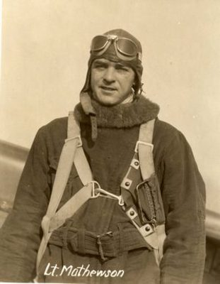
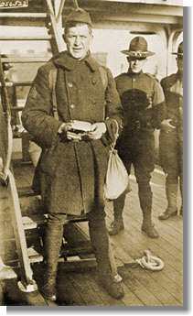
Hall of Famers in World War I
Casey Stengel
New York Yankees
Ty Cobb
Detroit Tigers
Christy Mathewson
New York Giants
Grover Cleveland Alexander
Phillies & Cardinals
Notes:
Some of the Ballplayers had light duty at home, and never saw combat. Casey Stengel was assigned to the Brooklyn Navy Yards, where he ran the Navy baseball team. Ty Cobb also did not see combat, as he was an Army reservist.
However, two HOF pitchers did see action in France during the war: Christy Mathewson was a captain the Army’s Chemical Warfare division, and while in France he was exposed to mustard gas. Mathewson survived the war, but died in 1925 at the age of 45 of tuberculosis.
Pete Alexander was a sergeant inan artillery unit, and spent two months on the front lines in France – the artllery caused deafness in his left ear. Also, he caught shrapnel on his right ear and experienced some muscle damage in this right arm. Nonetheless, after WW I, Alexander pitched another 9 years until the age of 40.

Slide 10
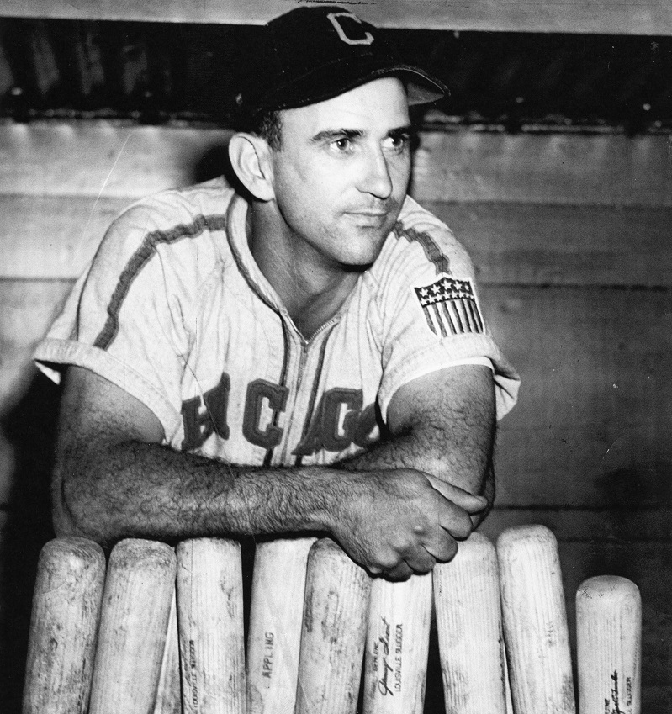
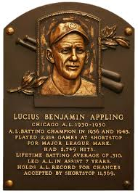
Luke Appling, United States Army
Chicago White Sox SS (HOF)
When Appling entered the Army in January 1944, his wife said “The war will be over soon because, outside of baseball, Luke never held a job for over two weeks.”
Notes:
Appling was shortstop for White Sox from 1930-1950, missing one year during WW II. Lifetime batting average of .310, with two batting titles.

Slide 11
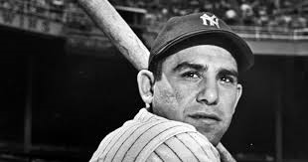
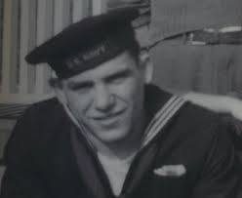
Seaman 2nd Class Yogi Berra, U.S. Navy
New York Yankees C (HOF)
Yogi was a Gunner’s Mate on a rocket-launching landing craft on Omaha Beach during D-Day on June 6, 1945. He said “it was just like a 4th of July celebration.”
Notes:
During Yogi’s 19 year playing career, he appeared in 14 World Series with Yankees – of which they won 9. Won MVP in 1951, 1954 and 1955.

Slide 12
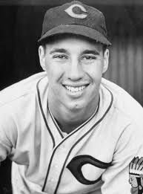
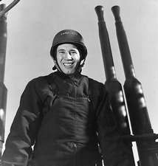
Chief Specialist Bob Feller, U. S. Navy
Cleveland Indians P (HOF)
Feller was chief of an anti-aircraft crew on the USS Alabama for during WWII.
Notes:
Feller’s baseball career spanned 18 years, and he missed 3 years due to WW II. Won 20 games or more 6x , and led the league in K’s 7 years. He was a member of the Indians last World Championship team in 1948. During an interview late in his life, Feller was asked about his military service and the interviewer referred to him as a “hero”. Feller just laughed and replied, “Heroes don’t come back.”

Slide 13
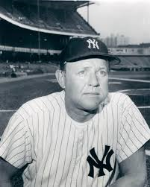
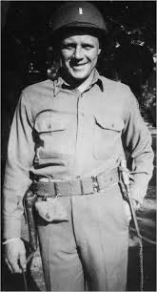
Major Ralph Houk, U. S. Army
New York Yankees C/Mgr
Houk landed at Omaha Beach on D-Day and later fought at the Battle of the Bulge. He was awarded the Bronze Star, Purple Heart and Silver Star for his service as a platoon leader.
Notes:
Houk was a backup catcher for the Yankees for 8 seasons, but was better known as a manager for 20 years in the American League. Won 2 World Series – 1961-62.

Slide 14
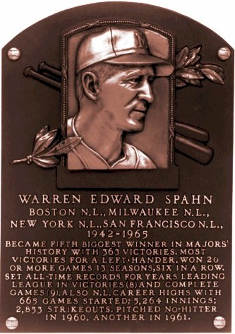
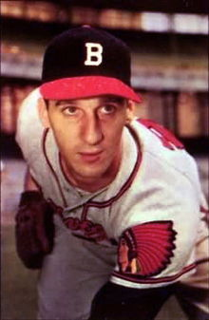
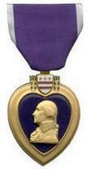
1st Lt. Warren Spahn, U. S. Army
Boston/Milwaukee Braves (HOF)
“The Army taught me something about challenges, and about what’s important and what isn’t.”
Notes:
Drafted in 1942 soon after making his major league debut that year with the Boston Braves, Spahn was assigned to an engineering Battalion. In Europe, at the Battle of the Bulge, he earned the Bronze Star and a Purple Heart. He likely became the only major league player to receive a battlefield commission.
Spahn is the winningest lefthanded pitcher in major league history – 363 wins over 21 year career, lost 3 years to military service.

Slide 15
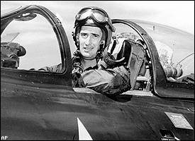
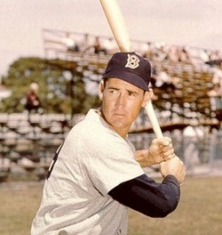
2nd Lt. Ted Williams, U. S. Marine Corps
Boston Red Sox (HOF)
Williams flew 39 combat missions in Korea. During half of those missions, he was John Glenn’s wingman.
Notes:
Ted Williams enlisted in the Navy in May 1942, and continued to play baseball that season. He won the triple crown in baseball in 1942 (.356/36/137). After the season ended he joined the Naval Aviator program. He didn’t serve overseas during WW-2. After the war, he returned to the Red Sox, and was the AL MVP in 1946.
He was recalled to active duty in 1952, and learned to fly the Grumann F9 Panther.
Williams had a 19-year career, missing 4 full years to military service. Considered by many the greatest hitter in baseball history, a lot of folks talk about how great his baseball stats may have been with those missing years. Years later when he was asked about that he said: "The three years that I lost - hell, there were nine billion guys who contributed a lot more than I did."

Slide 16
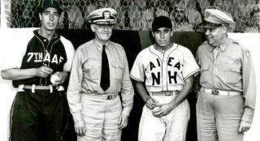
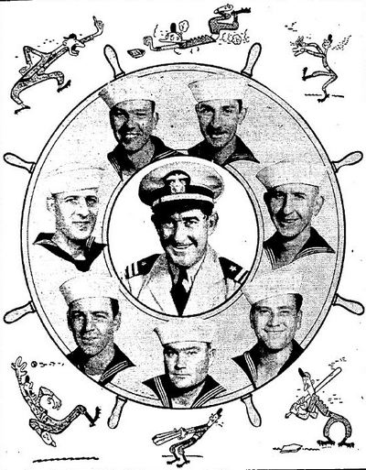
KEEP ‘EM PLAYING
Great Lake Navy Team in 1943 featured Mickey Cochrane and Johnny Mize
Joe Dimaggio (Army) and Pee Wee Reese (Navy) played against each other for the Central Pacific Service Championship in 1944.
Notes:
More than 500 major league ballplayers served in the military during WW2; including several well known players – Stan Musial, Joe DiMaggio and Ted Williams. Also, more than 4,000 minor league players served during WW2.
But, although players were enlisting or being drafted into the armed forces from the beginning, their existed an undertone of displeasure towards seemingly fit men participating in sports and apparently evading military duties. Some thought baseball squandered manpower and should be shut down for the duration. In response to the negative undertones, The Sporting News took it upon themselves, in April 1942, to ask servicemen for their view on the situation - should baseball continue while they fight and perhaps die for democracy and freedom? An overwhelming majority of replies from armed forces members strongly backed the President's directive to keep baseball going. A Private at Fort Knox, Kentucky summed it up: "For the morale of the soldier and the morale of America itself, 'keep 'em playing'."

Slide 17
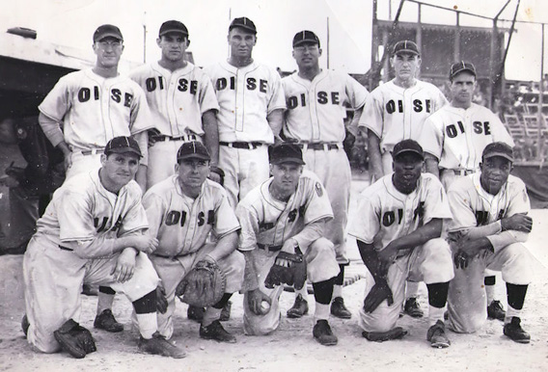
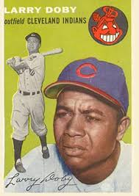
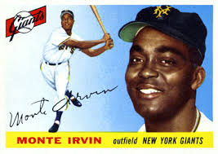
Negro League players in World War II
“If they can fight and die on Okinawa and Guadacanal…(then) they can play baseball in America.”
OISE All Stars, featured future HOFers Leon Day and Willard Brown. This team won the 1945 European Theater “world series”.
Notes:
More than 220 Negro League ballplayers served during WW 2. The Overseas Invasion Services Expedition (OISE) all star team in Europe featured two former Negro league stars – Willard Brown and Leon Day, - both were later inducted into the Hall of Fame. Day took part in the D-day invasion at Normandy. The OISE all stars defeated another military service team for the European Theater “World series”. Day and Brown never got a chance to play in the major leagues; but two former Negro League players who served in WW2 and did make it to the majors were Monte Irvin and Larry Doby – both ended up in the HOF.

Slide 18
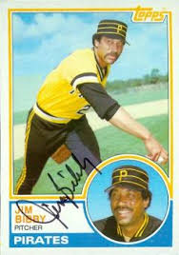
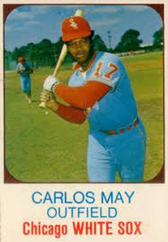
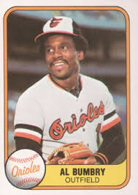
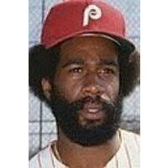
Baseball and Vietnam
113 major leaguers served in the military service during the Vietnam War
Notes:
113 major league ball players served in the military during the Vietnam War. Most of them enlisted in the reserves; however, some notable players that served in Vietnam were pitchers Jim Bibby and Ed Figueroa and outfielders Al Bumbry, Garry Maddox and Carlos May. Two lesser known players – Chuck Goggin and Roy Gleason – received purple hearts.
Bibby was a truck driver for the Army in Vietnam.
Bumbry had one of the most distinguished tenures. As a platoon leader, he earned the Bronze Star for heroism.
Another player who earned a Bronze Star was Bobby Jones – a utility infielder for the Rangers during 70’s and 80’s. Jones later became a very successful minor league manager in the Rangers farm system- a minor league coach for 25 years, including 3 years as manager of the Round Rock Express. He’s currently on the Texas Rangers coaching staff.
Ed Figueroa Joined the Marines, and served one year in Nam.
Garry Maddox was in the Giants minor league system, when he was drafted into the Army. While in Vietnam he was exposed to chemicals that damaged his skin. Leaving it highly sensitive and very difficult for Maddox to shave- so he grew a full beard, which became a trademark during his career.
Carlos May wasn’t stationed in Nam, but while at Camp Pendleton, a misfired mortar blew off part of his right thumb.. Doctors saved the use of his thumb; and although it was considerably shorter, May went on to have a successful major league career.

Slide 19
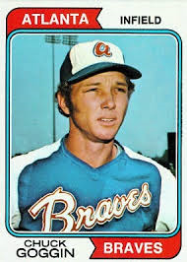
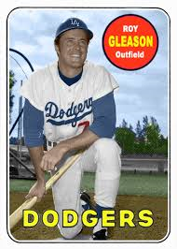
Some Major Leaguers Awarded the Purple Heart
Lou Brissie, Philadelphia A’s
Gene Bearden, Cleveland Indians
Bill Veeck, Chicago White Sox (Owner)
Bob Savage, Philadelphia A’s (3x)
Bert Shepard, Washington Senators
Rex Barney, Brooklyn Dodgers
Ralph Houk – NY Yankees
Hall of Famers:
Hoyt Wilhelm and Warren Spahn
Roy Gleason, LA Dodgers (Vietnam)
Chuck Goggin, Pirates (Vietnam)

