Slide 1
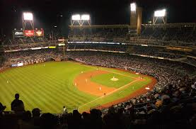
Old Stuff – New Stuff
Progress?

Slide 2
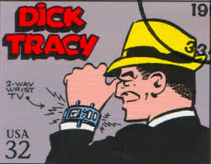
Dick Tracy’s Wrist Radio

Slide 3
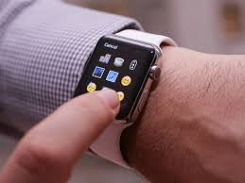
Apple Watch
Notes:
Video, phone, text messages, apps, fitness trackers………………………and time

Slide 4
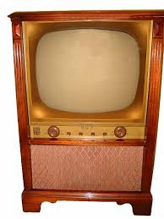
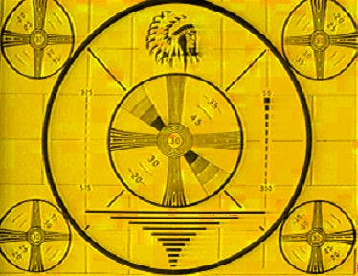
Television
Notes:
Remember when TV was not on 24/7? When we only had three channels?

Slide 5
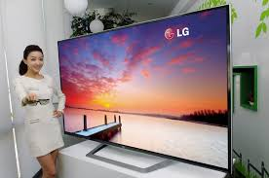
Television

Slide 6
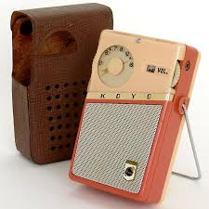
Transistor Radio
Notes:
Ever take your transistor radio to school to listen to World Series games? Only day games back then

Slide 7
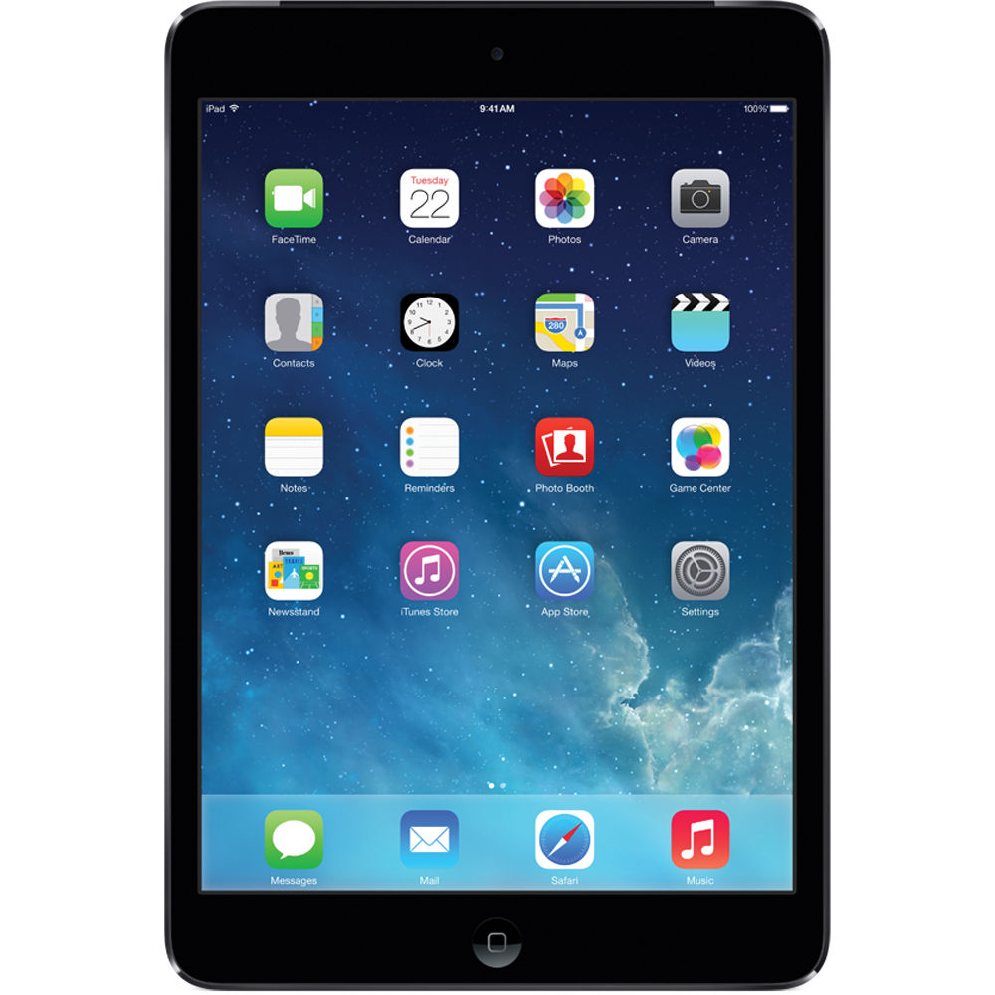
iPad
Notes:
Can hold 100s of thousands of songs – play movies, take pictures/videos, control your thermostat from work, etc

Slide 8
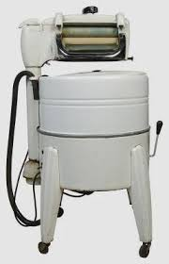
Washing Machine
Notes:
Note the wringer

Slide 9
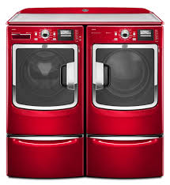
Washer and Dryer

Slide 10
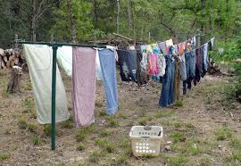
Dryer

Slide 11
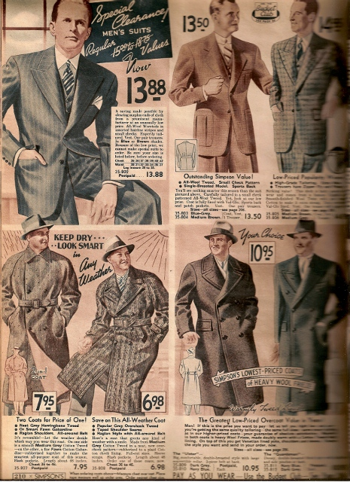
Sears Catalog

Slide 12
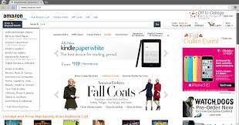
Amazon
Notes:
Can buy anything remotely and get them in 1 or 2 days

Slide 13
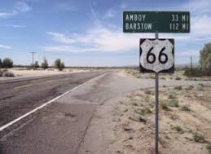
Route 66
Notes:
Old Route 66

Slide 14
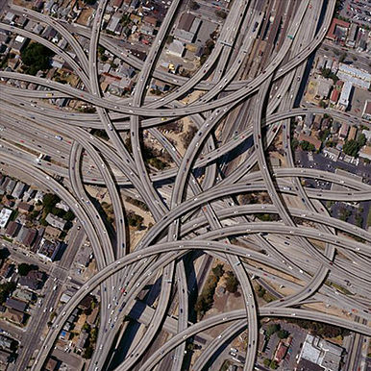
Dallas “Spaghetti Bowl”

Slide 15
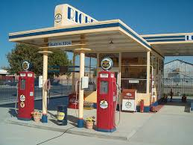
Service Station
Notes:
Remember when it was called a Service Station – Texaco, Esso, what other brands? People pumped gas for you!

Slide 16
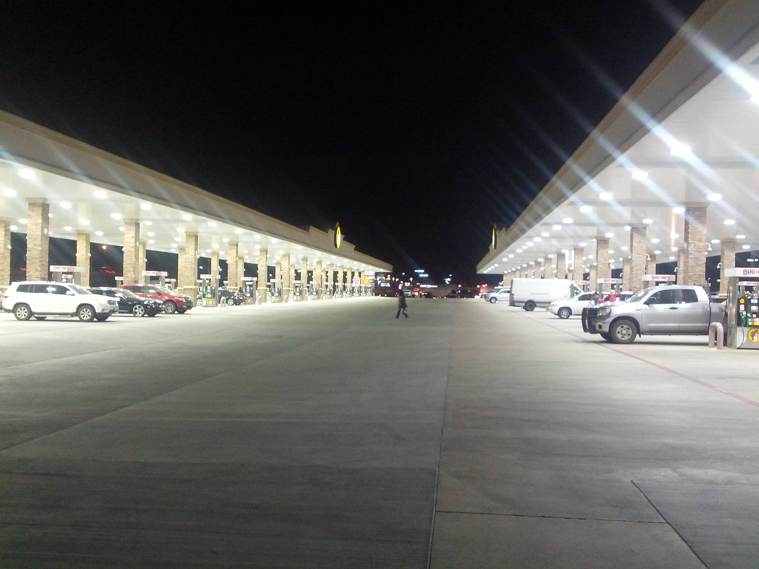
Buccee’s

Slide 17
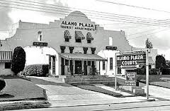
Motel
Notes:
Lack of standards – usually checked out room before paying. Many did not have TVs, fewer had pools

Slide 18
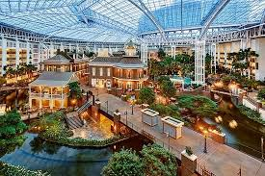
Opryland Hotel - Nashville
Notes:
Indoor area has steamship running in fake river

Slide 19
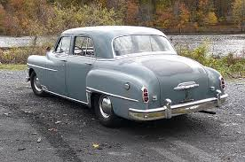
Desoto

Slide 20
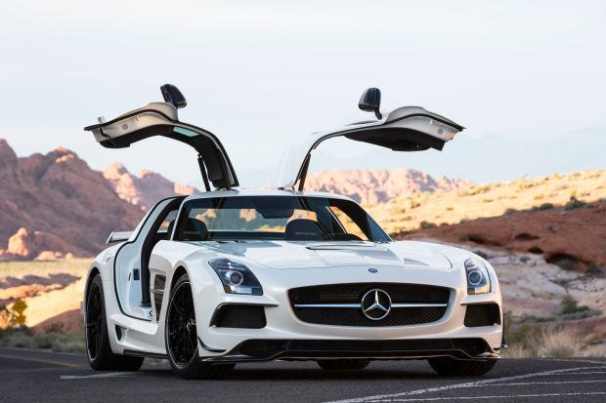
Mercedes Benz

Slide 21
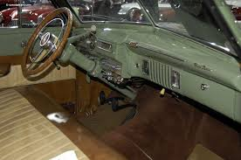
Desoto (interior)
Notes:
You were lucky (Rich?) if you had a radio; no seatbelts, probably no air conditioning

Slide 22
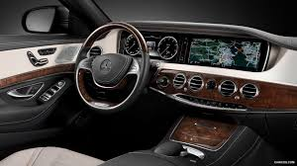
Mercedes Benz (interior)

Slide 23
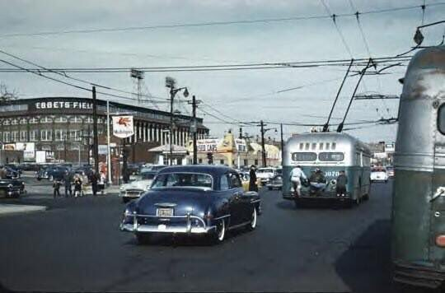
Public Transportation
Notes:
See the kids on the back of the trolley!

Slide 24
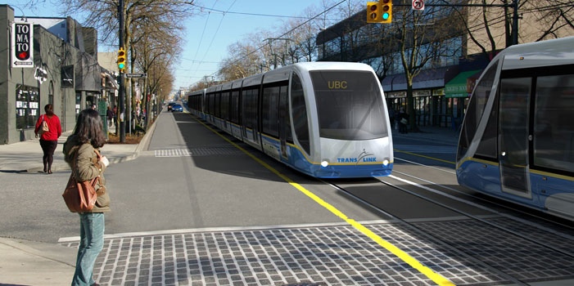
Public Transportation

Slide 25
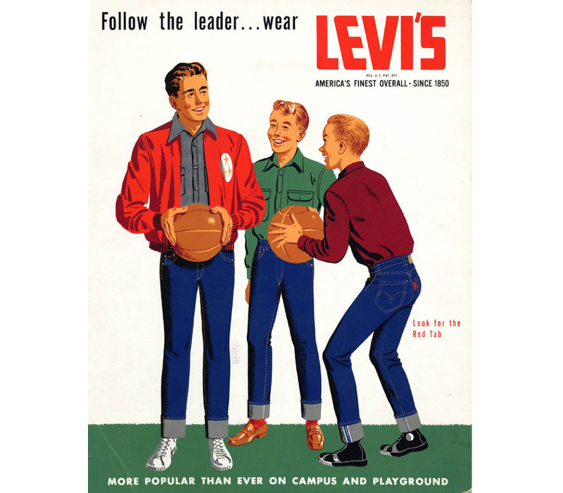
Blue Jeans

Slide 26
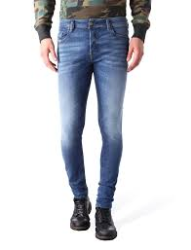
Skinny Jeans

Slide 27
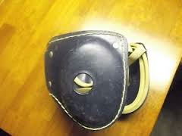
Little League Batting Helmet

Slide 28
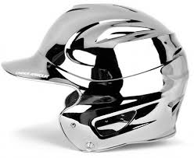
Little League Chrome Batting Helmet

Slide 29
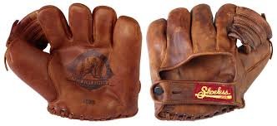
Little League Gloves

Slide 30
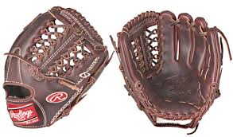
Little League Gloves

Slide 31
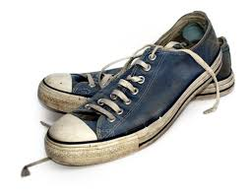
Sneakers

Slide 32
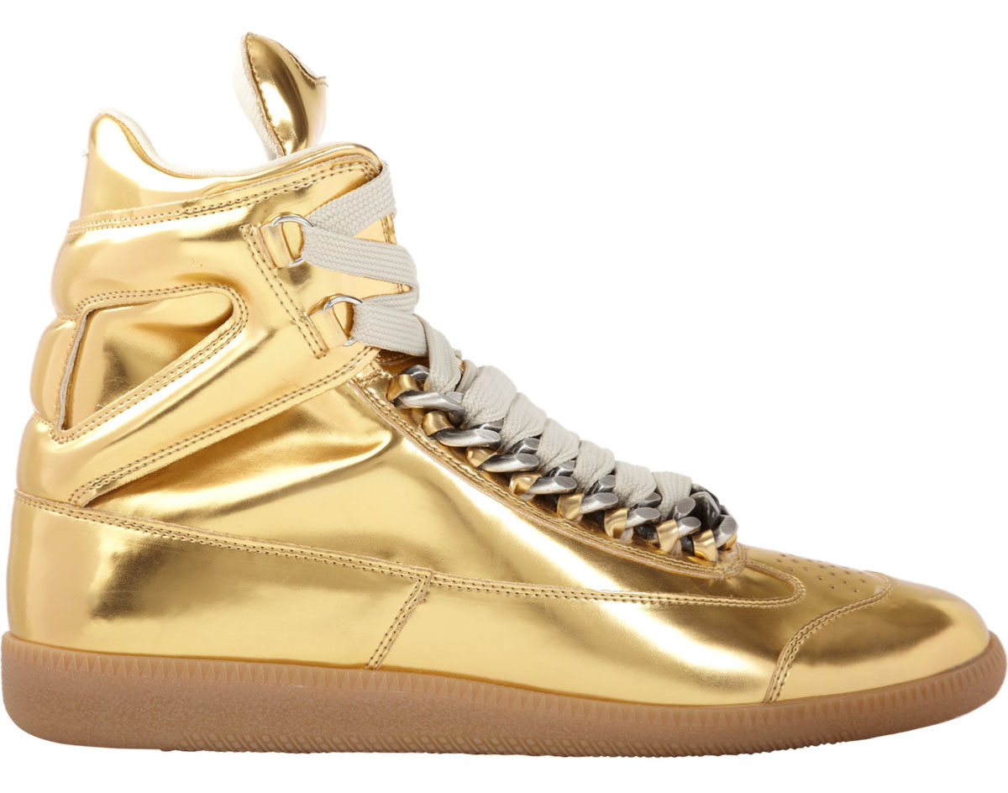
Sneakers
Notes:
What would have happened to a kid if he wore these shoes to Little League practice in 1958?

Slide 33
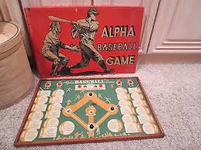
Baseball Board Game

Slide 34
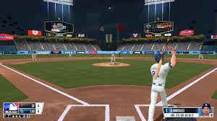
Baseball Game (screen shot)

Slide 35
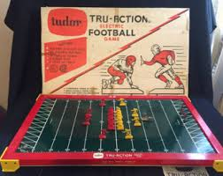
Electric Football Game

Slide 36
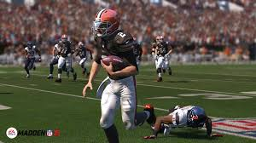
Madden Football Game (screen shot)

