Slide 1
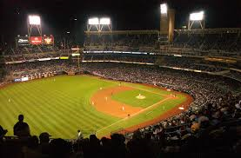
Pitchers

Slide 2
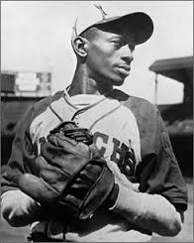
“My pitching philosophy is simple - keep the ball way from the bat.”
- Satchel Paige, HOF Pitcher
*There are 77 pitchers in the Hall of Fame. Paige was inducted in 1971.

Slide 3
Satchell Paige had names for most of his pitches:
Midnight Rider
Four-day Creeper
Bat Dodger
Wobbly Ball
Nothin’ Ball
Two-hump Blooper
Drooper
Looper
Hurry-up Ball
Smoke Ball
Bee Ball
Aspirin

Slide 4
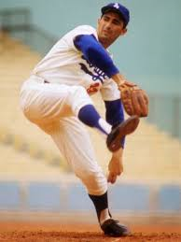
“Pitching is the art of instilling fear.”
- Sandy Koufax, Pitcher
* Koufax was inducted into the Hall of Fame in 1972

Slide 5
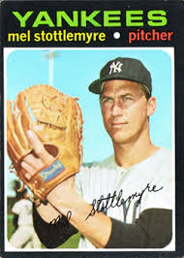
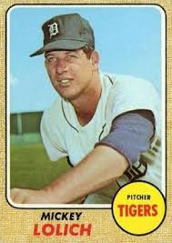
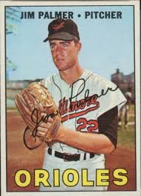
Ira’s favorite Pitchers
Mel Stottlemyre
New York Yankees
Mickey Lolich
Detroit Tigers
Jim “Cakes” Palmer
Baltimore Orioles
Notes:
Three Hall of Fame catchers. Ernie “Schnozz” Lombardi was still playing when Bill started following baseball

Slide 6
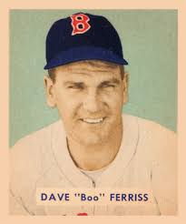
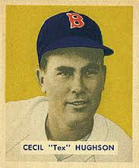
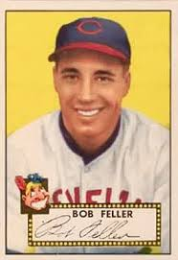
Tom’s favorite Pitchers
Dave “Boo” Ferriss
Boston Red Sox
Tex Hughson
Boston Red Sox
Bob Feller
Cleveland Indians
Notes:
Three Hall of Fame catchers. Ernie “Schnozz” Lombardi was still playing when Bill started following baseball

Slide 7
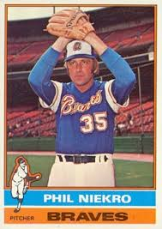
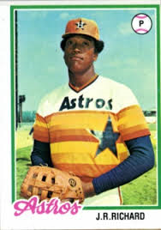
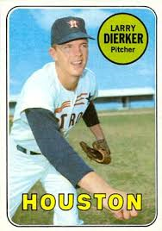
Bobby’s favorite Pitchers
Phil Niekro
Atlanta Braves
J.R. Richard
Houston Astros
Larry Dierker
Houston Astros
Notes:
Three Hall of Fame catchers. Ernie “Schnozz” Lombardi was still playing when Bill started following baseball

Slide 8
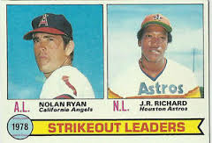
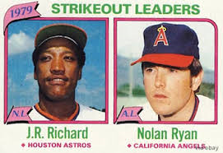
Bobby’s favorite Pitchers
Two more J.R. Richard Baseball Cards
Notes:
Three Hall of Fame catchers. Ernie “Schnozz” Lombardi was still playing when Bill started following baseball

Slide 9
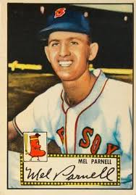
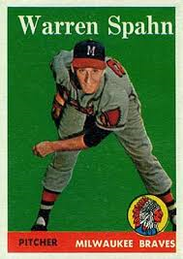
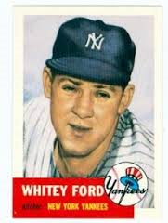
Who was your favorite Pitcher?
Mel Parnell
Boston Red Sox
Warren Spahn
Milwaukee Braves
Whitey Ford
New York Yankees

Slide 10
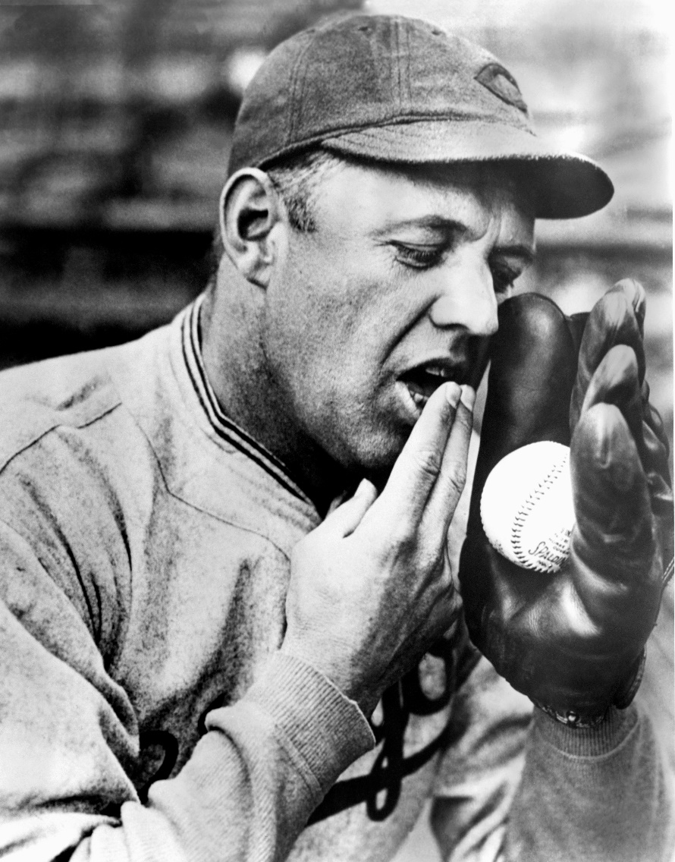
Spitball
Spitball was outlawed in 1920
Burleigh Grimes (pictured left) was inducted into the Baseball Hall of Fame in 1964

Slide 11
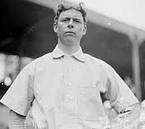
Curveball
Mordecai “Three Finger” Brown (pictured above) lost parts of two fingers and had his hand mangled in two separate farming accidents as a kid
He learned how to grip the baseball in a way that resulted in an exceptional curveball
He was inducted into the Baseball Hall of Fame in 1949

Slide 12
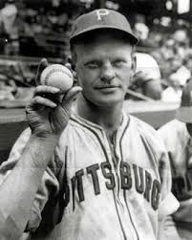
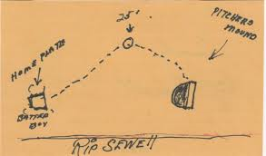
Eephus Pitch
Rip Sewell threw the ball as slow as 55 mph and up to 25’ high
He only gave up one home run using the pitch – to Ted Williams in the 1946 All Star game
Notes:
Click on drawing to get hyperlink to Ted Williams home run off of Rip Sewell in All Star game

Slide 13
Pitchers have been some of the biggest flakes in Baseball History
Can You Guess Some of Them?

Slide 14
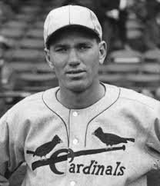
Dizzy Dean – Ball Player
“It ain’t bragging if you can back it up!”
"It puzzles me how they know what corners are good for filling stations. Just how did they know gas and oil was under there?"
"Sure I eat what I advertise. Sure I eat Wheaties for breakfast. A good bowl of Wheaties with bourbon can't be beat."

Slide 15
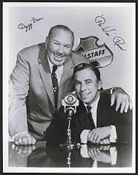
Dizzy Dean – Baseball Broadcaster
“He slud into third.”
“Slud is something more than slid. It means sliding with great effort.”
“Let the English teachers teach English and I will teach baseball. There is a lot of people in the United States who say “isn’t”, and they ain’t eating.

Slide 16
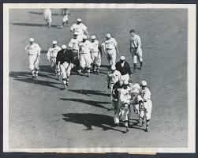
Dizzy Dean – 1934 World Series
In Game 4 of the Series, Dean was hit in the head by a throw while trying to break up a double play. He was knocked unconscious.
News paper headline - “X-Ray of Dean’s head reveals nothing.”
Dean quote – “They x-rayed my head and found nothing.”

Slide 17
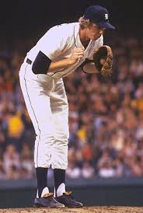
Mark Fidrych
“He talks to the ball. ... He talks to himself. ... He gestures toward the plate, pointing out the path he wants the pitch to take. ... He struts in a circle around the mound after each out, applauding his teammates and asking for the ball. .... And he’s forever chewing gum and patting the dirt on the mound with his bare hand.”
- The Sporting News (6/5/76)
Notes:
Click on picture of Fidrych to have video highlights

Slide 18
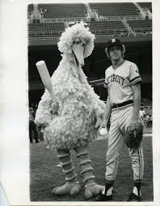
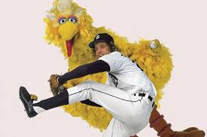
Mark “The Bird” Fidrych
A minor league manager nicknamed him “The Bird” because he thought he looked liked Sesame Street’s Big Bird

Slide 19
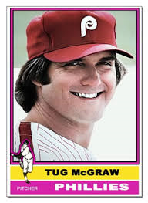
Tug McGraw - Pitcher
When asked if he preferred grass or Astroturf - “I don’t know. I’ve never smoked Astroturf.”
When asked how he would spend his signing bonus – “Ninety percent I'll spend on good times, women and Irish Whiskey. The other ten percent I'll probably waste.”

Slide 20
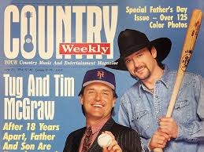
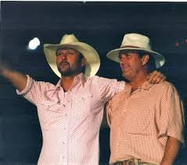
Tug McGraw - Father
Tug McGraw’s son is country music star, Tim McGraw

Slide 21
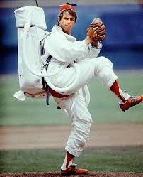
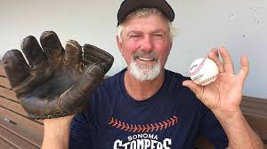
Bill “Spaceman” Lee
Lee still plays baseball for the Burlington Cardinals, a senior league team in Vermont
Lee is the 2016 Liberty Union party candidate for Vermont Governor
Notes:
Eephus pitch – click on Spaceman picture to get video of Lee MoonBall hit for 2 run HR by Tony Perez in Game 7 of 1975 World Sereis

Slide 22
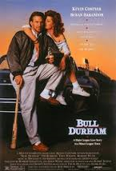
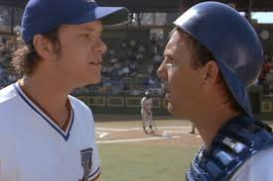
Nuke LaLoosh
Nuke LaLoosh (Tim Robbins)
Crash Davis (Kevin Costner)

Slide 23
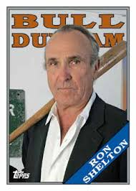
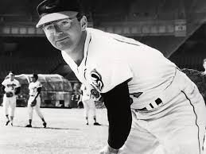
Nuke LaLoosh
Film Director, Ron Shelton, played minor league baseball with pitcher Steve Dalkowski. Dalkowski was the inspiration for Nuke LaLoosh.
Dalkowski averaged 12.63 strikeouts per 9 innings, but…………………….

Slide 24
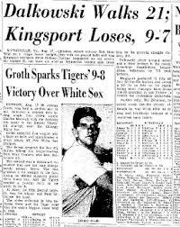
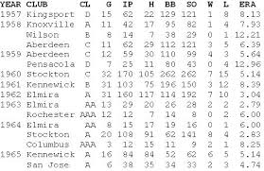
He also averaged 12.25 walks per 9 innings

Slide 25
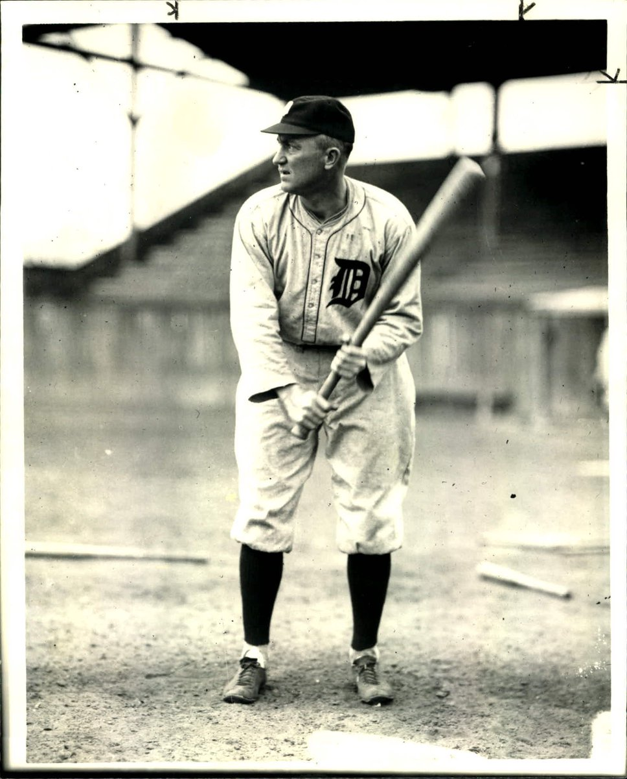
Not a pitcher – Ty Cobb
Ty Cobb Batting Fundamentals (1938)
“DON'T GRIP YOUR BAT AT THE VERY END; leave say an inch or two. ALSO, LEAVE AT LEAST AN INCH OR MORE SPACE BETWEEN YOUR HANDS; that gives you balance and control of bat, and also keeps hands from interfering with each other during swing.”
Cobb has the highest career batting average in major league history - .366

