Slide 1
The Year in Baseball: 1967

Slide 2
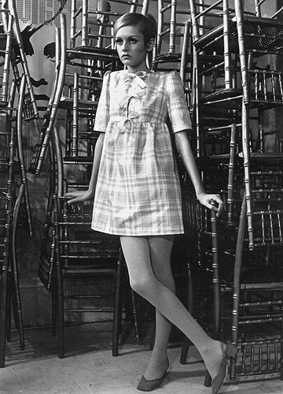
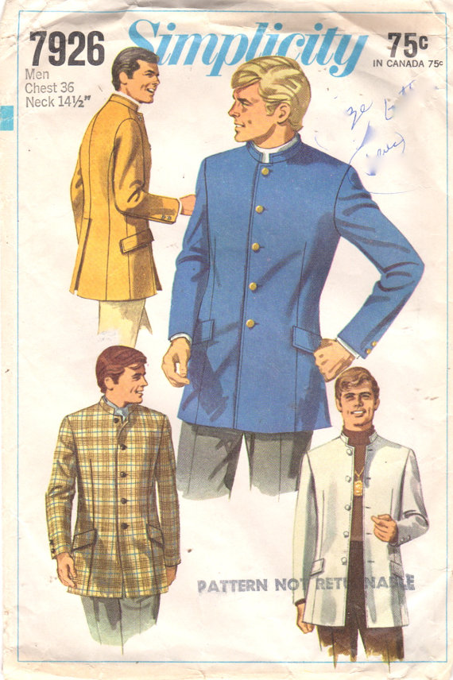
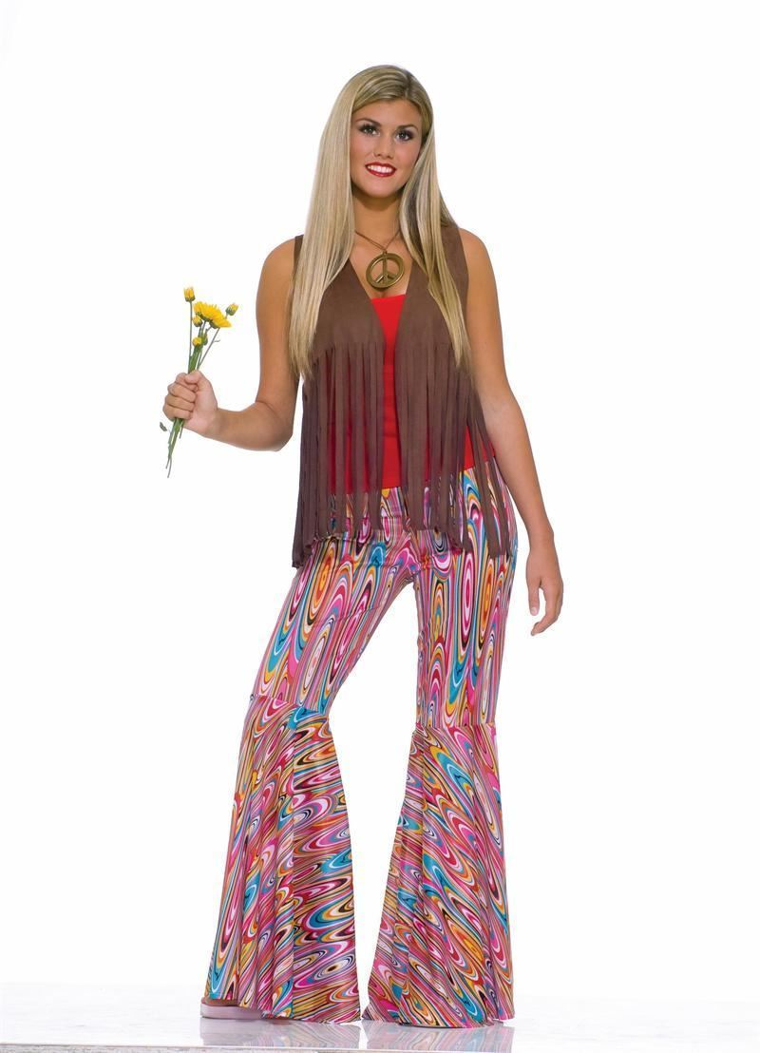
1967 -- Off the Field:
It was a time of “Mod” fashions…
Notes:
Twiggy, the Nehru jacket, bell-bottoms & flower power, the bouffant hair-do

Slide 3
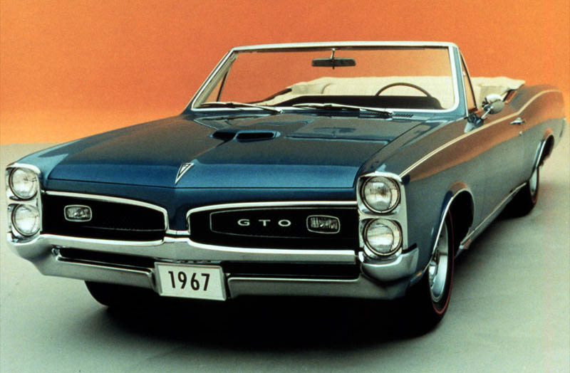
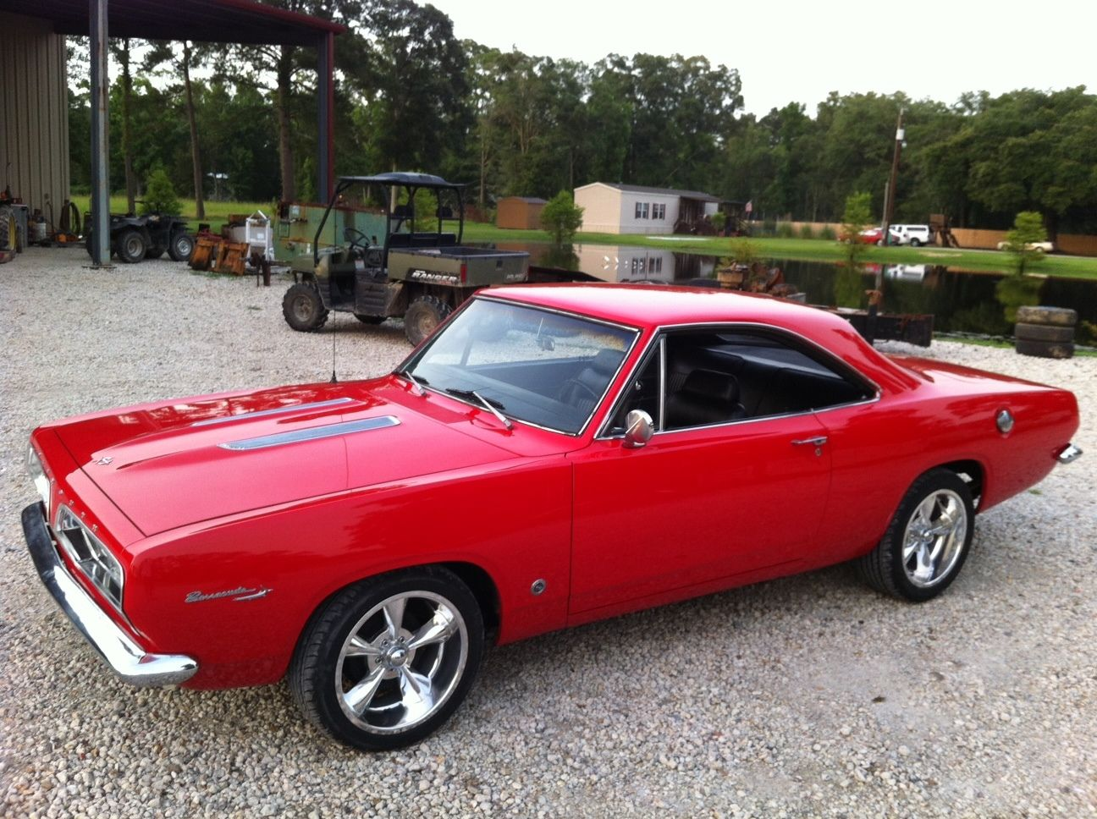
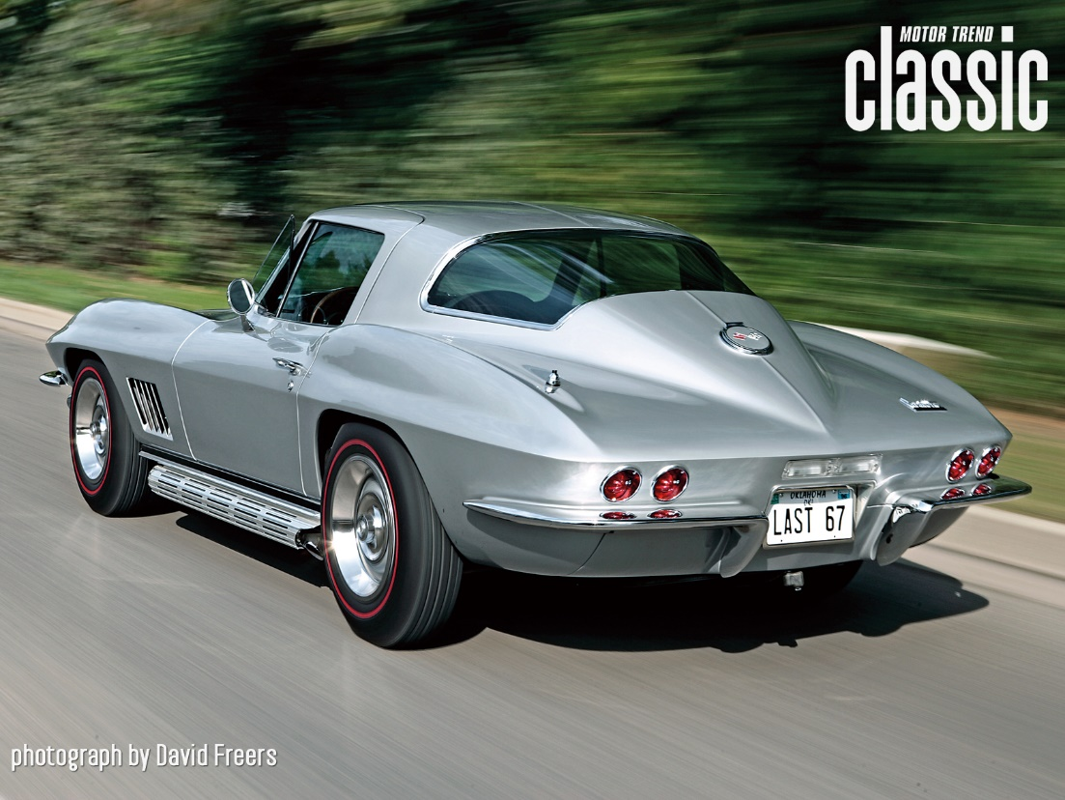
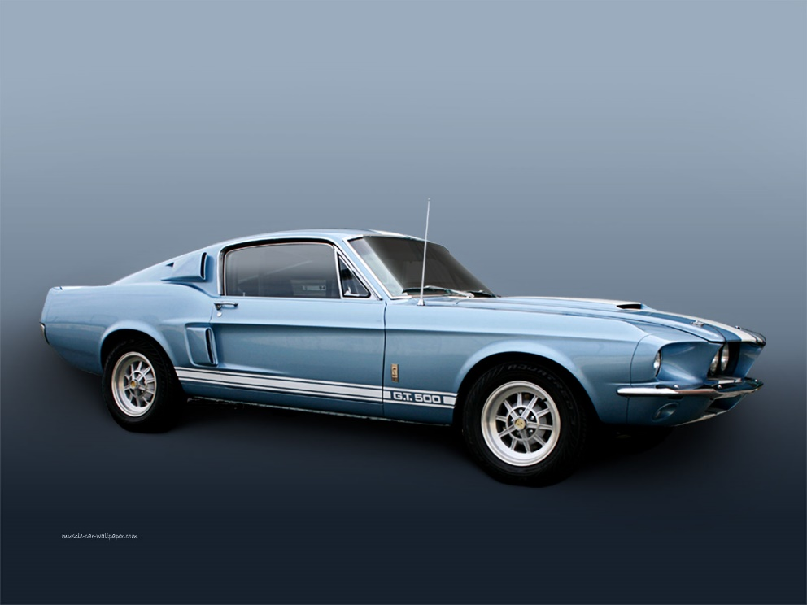
… and
“muscle cars”
Notes:
Pontiac GTO, Plymouth Barracuda, Chevy Corvette “Sting Ray”, and first year of the Shelby GT500 Mustang

Slide 4
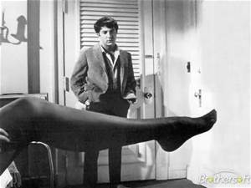
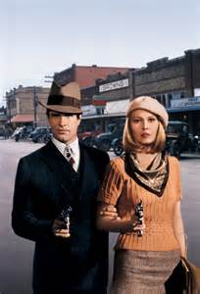
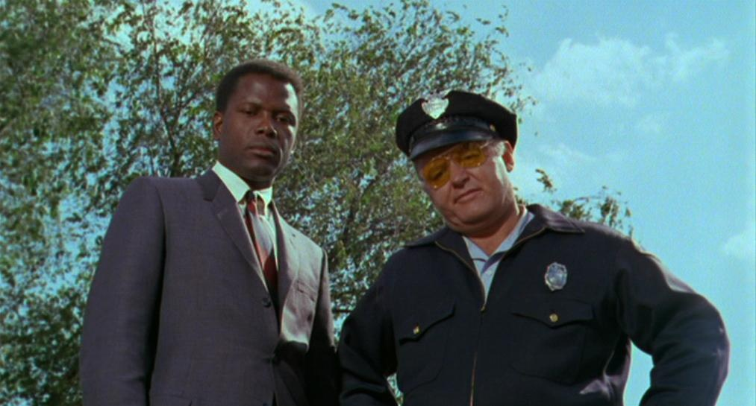
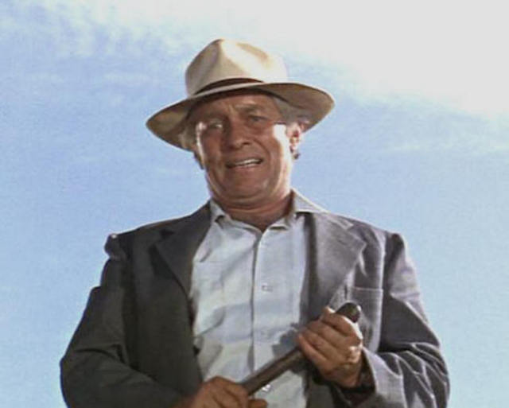
1967 -- Off the Field:
… and some classic movies.
Notes:
I’ll give you a famous line from the movie, and you tell me the movie’s name -- 1. “We’re the Barrow Gang. We rob banks.” Bonnie and Clyde 2. “They call me Mr. Tibbs!” In the Heat of the Night 3. “Mrs. Robinson, are you trying to seduce me?” The Graduate 4. “What we’ve got here is a failure to communicate.” Cool Hand Luke

Slide 5
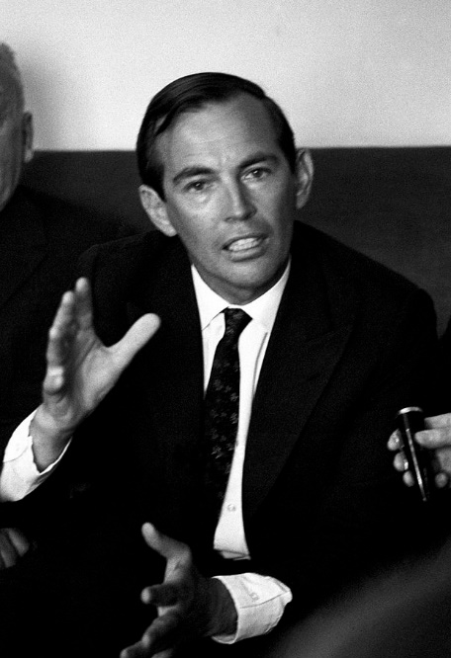
1967 -- Off the Field:
This man performed the first-ever heart transplant operation
Notes:
Dr. Christiaan Barnard of South Africa performed the world’s first heart transplant in December 1967.

Slide 6
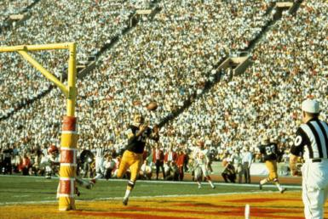
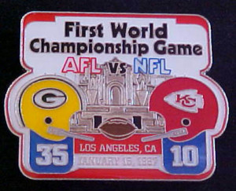
1967 -- On the Field: … the pro football field

Slide 7
1967 -- On the Field:
Future Hall of Famers that were rookies in ’67 Hit his 500th home run
Notes:
Reggie Jackson, Tom Seaver, Rod Carew, and Johnny Bench were all rookies in 1967 … on their way to the Hall of Fame. Mickey Mantle hit his 500th HR.

Slide 8
1967 -- On the Field:
League Most Valuable Players:
“Yaz”
“Cha Cha”
Notes:
Yaz won the triple crown with .326, 44 HR, and 121 RBI. Orlando Cepeda hit .325, had 25 HR and led NL with 111 RBI.

Slide 9
1967 -- On the Field:
Cy Young Award Winners:
Jim Lonborg
22-9 3.16 ERA 273 IP 246 K
Mike McCormick
22-10 2.85 ERA 262 IP 150 K
Notes:
1967 was the first year that a Cy Young Award was given to pitchers in each league. From ‘56 to ‘66 was only given to one pitcher across all of MLB.

Slide 10
1967 – On the Field:
League Leaders in Stolen Bases
Lou Brock
52 steals
Dagoberto “Bert” Campaneris
55 steals
Notes:
Note Campaneris’ cap – this was the last year the Athletics played in Kansas City
Mickey Mantle hit 37 homers to lead the AL. He also led the league in triples, walks, and SLG.

Slide 11
1967 -- On the Field: Final Regular Season Standings
1967 National League Team Standings
Team | Wins | Losses |  | GB
Cardinals | 101 | 60 |  | 0
Giants | 91 | 71 |  | 10 1/2
Cubs | 87 | 74 |  | 14
Reds | 87 | 75 |  | 14 1/2
Phillies | 82 | 80 |  | 19 1/2
Pirates | 81 | 81 |  | 20 1/2
Braves | 77 | 85 |  | 24 1/2
Dodgers | 73 | 89 |  | 28 1/2
Astros | 69 | 93 |  | 32 1/2
Mets | 61 | 101 |  | 40 1/2
1967 American League Team Standings
Team | Wins | Losses |  | GB
Red Sox | 92 | 70 |  | 0
Tigers | 91 | 71 |  | 1
Twins | 91 | 71 |  | 1
White Sox | 89 | 73 |  | 3
Angels | 84 | 77 |  | 7 1/2
Senators | 76 | 85 |  | 15 1/2
Orioles | 76 | 85 |  | 15 1/2
Indians | 75 | 87 |  | 17
Yankees | 72 | 90 |  | 20
Athletics | 62 | 99 |  | 29 1/2

Slide 12
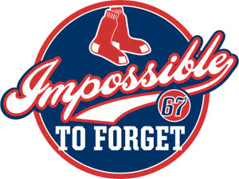
1967 World Series
vs.
“The Impossible Dream” collides with “El Birdos”

Slide 13
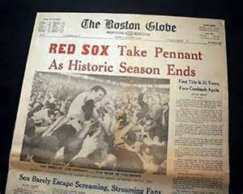
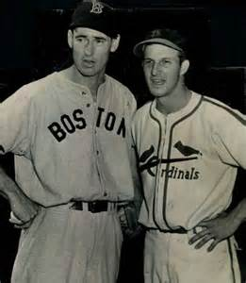
1967 World Series
“First Title in 21 Years,
Face Cardinals Again”
A rematch of the
1946 World Series

Slide 14
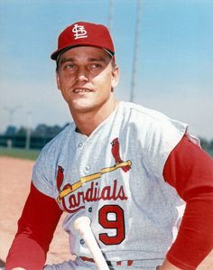
1967 World Series – key Cardinals
Maury Wills
Ron Fairly
Wes Parker
Lou Brock Roger Maris Julian Javier Bob Gibson Mgr. Red Schoendienst
Don Drysdale
Sandy Koufax
Claude Osteen
Notes:
Mickey Mantle hit 37 homers to lead the AL. He also led the league in triples, walks, and SLG.

Slide 15
1967 World Series – key Red Sox
Reggie
Smith
Yaz
Tony Oliva
George
Scott
Jim Lonborg
Mgr. Dick Williams
Rico
Petrocelli
Camilo Pasqual
Notes:
Key Red Sox – Yaz, Reggie Smith, George Scott, and Rico Petrocelli; pitcher Jim Lonborg; Mgr Dick Williams
Mickey Mantle hit 37 homers to lead the AL. He also led the league in triples, walks, and SLG.

Slide 16
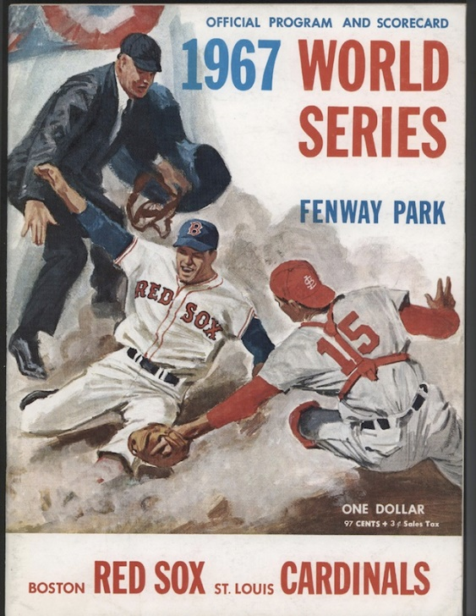
1967 World Series Game 7 Fenway Park
https://www.youtube.com/watch?v=SY2dJ0YATZY
Notes:
Game 7 played at Fenway Park on Thursday, October 12, 1967

Slide 17
… and now, for the rest of the story…
1946
1967
2004
2013
The Red Sox even up the all-time series in the 21st Century
… stay tuned for the next encounter !!
Notes:
The Cardinals won both Worlds Series vs. the Red Sox in the 20th Century, but the Red Sox have won both match-ups in the 21st Century … here are the World Series MVPs
… when will they meet again ???

